Slide 1


Machine Learning and Deep Learning
- the math you need to get started
By
Bharathi kannan N

Slide 2

Agenda
Introduction
Machine Learning Algorithms
Supervised Learning
Unsupervised Learning
Reinforcement Learning
Deep Learning
Applications
Programming Example

Slide 3
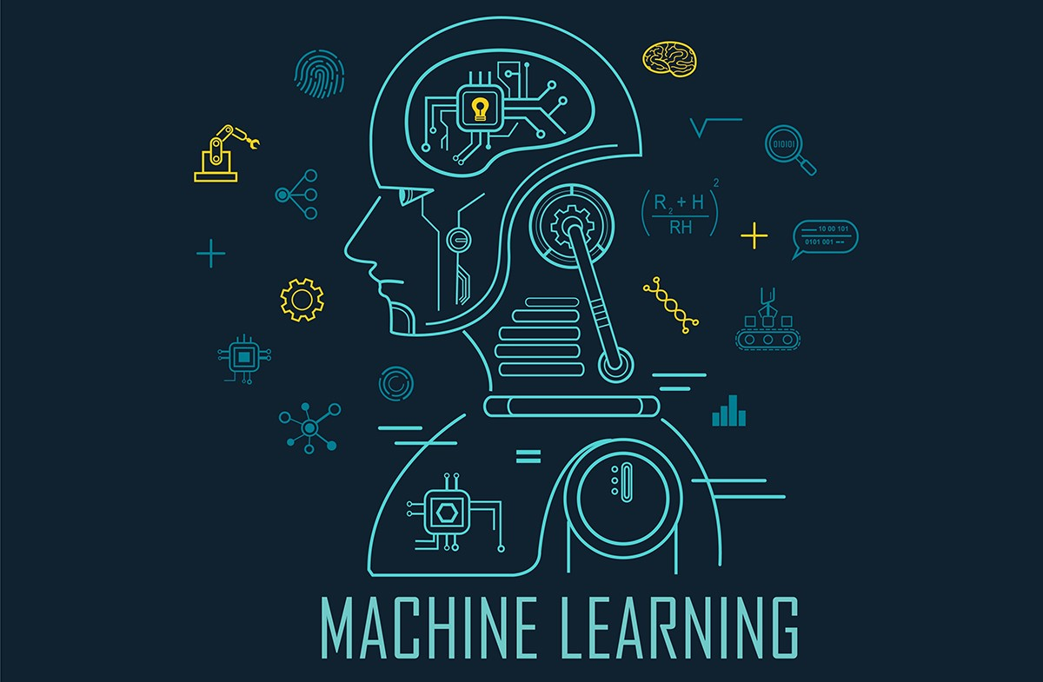

Slide 4

Machine Learning
Machine learning is a field of study that gives computers the ability to learn without being explicitly(clearly) programmed.
Tom Mitchell provides a more modern definition: “A computer program is said to learn from experience E with respect to some class of tasks T and performance measure P, if its performance at tasks in T, as measured by P, improves with experience E.

Slide 5

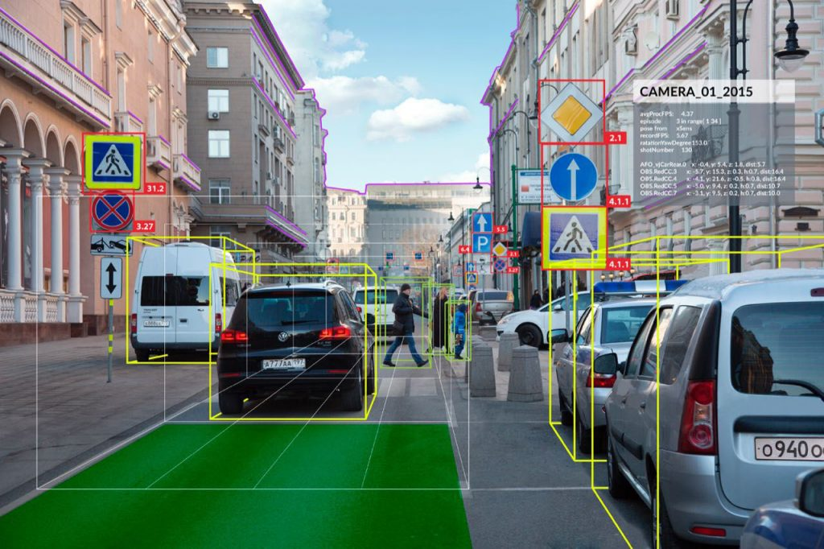
Why Machine Learning ?
Problem
Solution
Machine Learning uses algorithms that can learn from previous data and make predictions on the new data.
Can machines do what we do(as thinking entities)
Can even outperform humans in some tasks.
Practical Problems
Digit Recognition
Face Detection
Speech Understanding
Natural Language Processing
Product Recommendation
Spam Detection

Slide 6

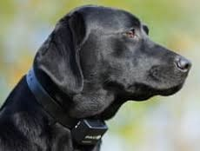
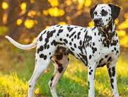
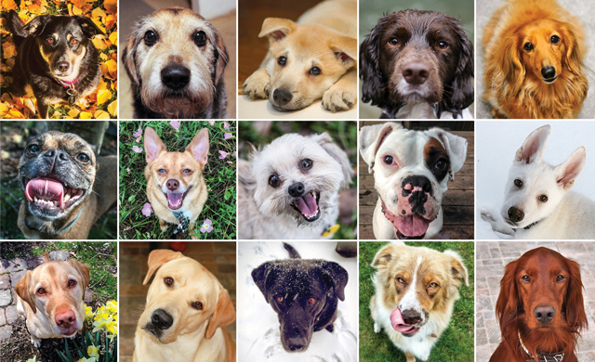
Why is it so powerful ?

Slide 8
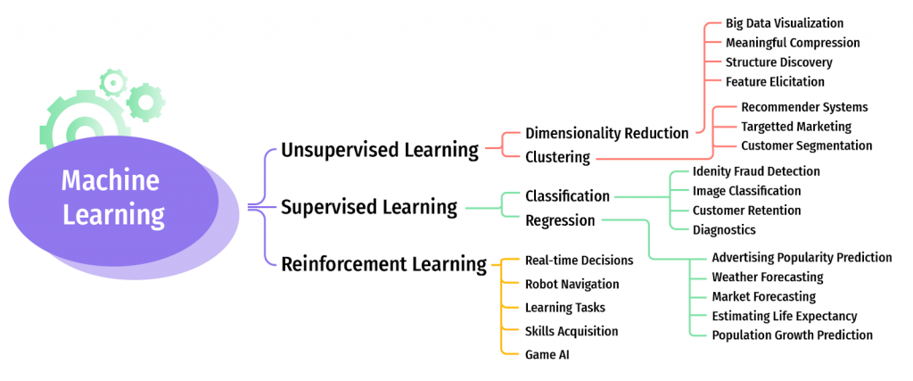
Machine Learning Algorithms
Supervised Learning
Unsupervised Learning
Reinforcement Learning
Regression
Clustering
Regression
Score Prediction
Price Prediction
Market Segmentation
Social Network Analysis
Score Prediction
Price Prediction
Classification
Classification
Dimensionality Reduction
Email Classification
Image Classification
Email Classification
Image Classification
Email Classification
Image Classification

Slide 9
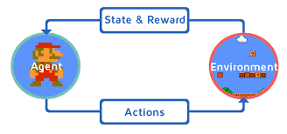
Algorithms
Supervised learning
Unsupervised learning
Reinforcement learning

Slide 10
Reinforcement learning

Slide 11



Action
State
Reward
Agent
Environment

Slide 12
A0
S1
R1
Now agent
is in S1
Agent in SO
Environment

Slide 13
A2
S2
R2
Agent in S1
Now agent
is in S2
Environment

Slide 14
This process continues

Slide 15
A1
S1
A1
Agent
Environment

Slide 16
A1
S1
A1
Agent
Environment

Slide 17
A1
S1
A1
Agent
Environment

Slide 18
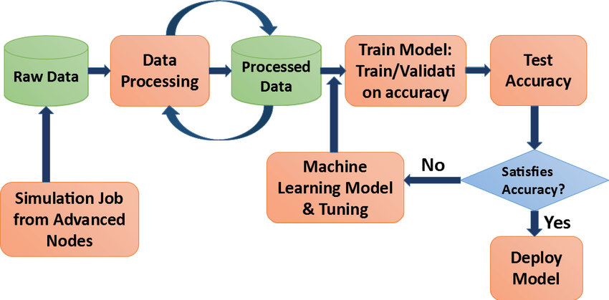
Machine Learning Process

Slide 19
Supervised Learning
Supervised learning is when the model is getting trained on a labelled dataset.
Labelled dataset is one which have both input and output parameters
Example :
Given data about the area of houses and their price, try to predict their price for new area.
Types:
1)Regression – output is continuous
2)Classification – output is discrete
Regression
Given a picture of a person, We have to predict his/her age(Continuous).
Classification
Given a picture of a person, We have to predict their gender (Male/Female) (Discrete).

Slide 20
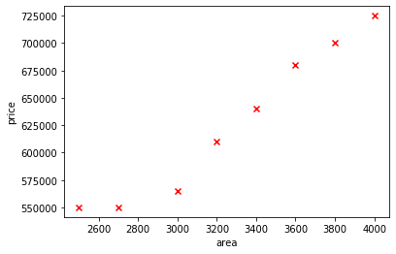
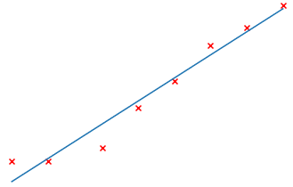
Linear Regression
Hypothesis
Prediction ​= weight * x + bias
Example
Prediction = weight * (2800) + bias​

Slide 21
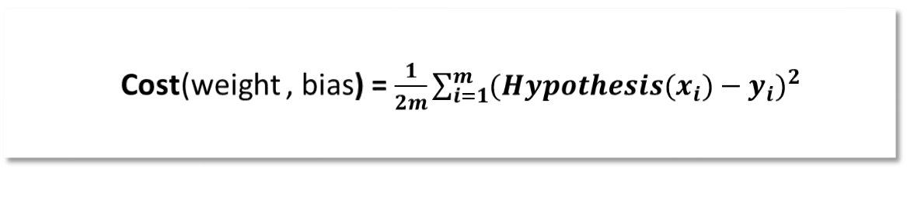
Cost Function
Accuracy of our hypothesis function can be measured by using cost function
Cost(weight , bias) = $\frac{1}{2m}\sum_{i=1}^{m}{{(Hypothesis(x_{i})−y_{i})}^{2} }$
m - Number of training examples.
$Hypothesis(x_{i})−y_{i }$ - Difference of Predicted and Original value.
Measuring the accuracy of our prediction function against the correct result.

Slide 22
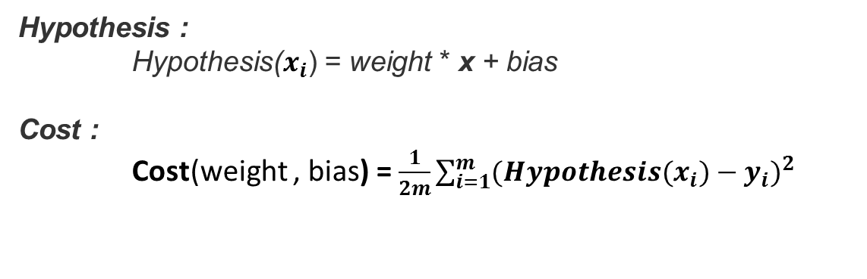
Our Goal
Hypothesis :
Hypothesis($x_{i}$) ​= weight * x + bias
Cost :
Cost(weight , bias) = $\frac{1}{2m}\sum_{i=1}^{m}{{(Hypothesis(x_{i})−y_{i})}^{2} }$
Goal :
minimize(cost(weight , bias))

Slide 23
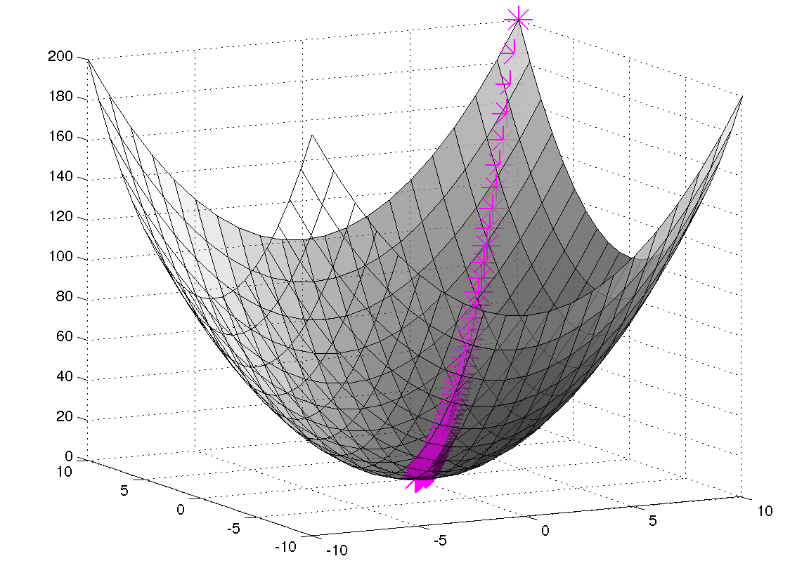
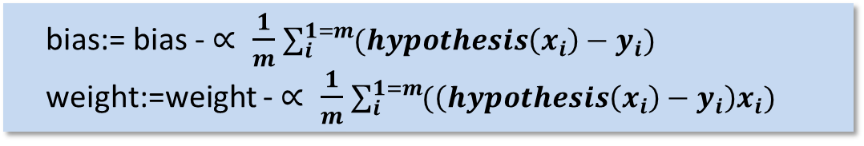
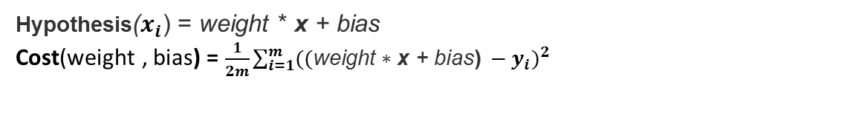
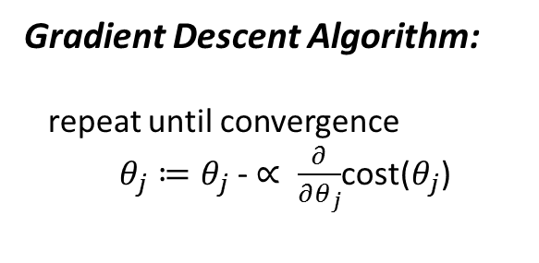
Gradient Descent
Gradient Descent Algorithm:
repeat until convergence
$θ_{j}≔θ_{j}$ - $∝ \frac{∂}{∂θ_{j}}$cost($θ_{j}$)
cost
Weight
bias
Hypothesis($x_{i}$) ​= weight * x + bias
Cost(weight , bias) = $\frac{1}{2m}\sum_{i=1}^{m}{{((\text{weight}\text{ ∗ }\text{x}\text{ + }\text{bias}\text{)} −y_{i})}^{2} }$
bias:= bias - $∝ \frac{1}{m}$ $\sum_{i}^{1=m}{(hypothesis\left(x_{i}\right)−y_{i})}$
weight:=weight - $∝ \frac{1}{m}$ $\sum_{i}^{1=m}{(\left(hypothesis\left(x_{i}\right)−y_{i}\right)x_{i})}$

Slide 24
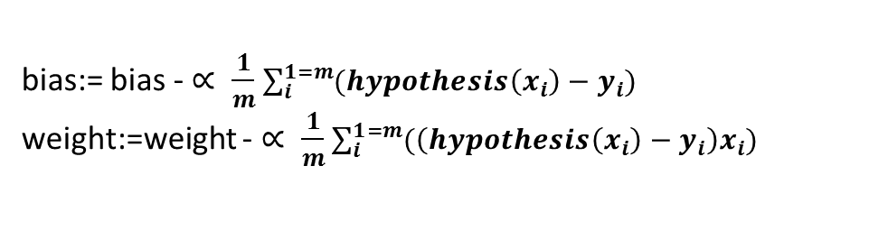
How it works
cost
weight
bias:= bias - $∝ \frac{1}{m}$ $\sum_{i}^{1=m}{(hypothesis\left(x_{i}\right)−y_{i})}$
weight:=weight - $∝ \frac{1}{m}$ $\sum_{i}^{1=m}{(\left(hypothesis\left(x_{i}\right)−y_{i}\right)x_{i})}$

Slide 25
Adding more features
Hypothesis
Prediction ​= weight1 * x1 +weight2 * x2+ bias
Example
Prediction = weight1 * (2800) weight2 *(10) + bias​

Slide 26
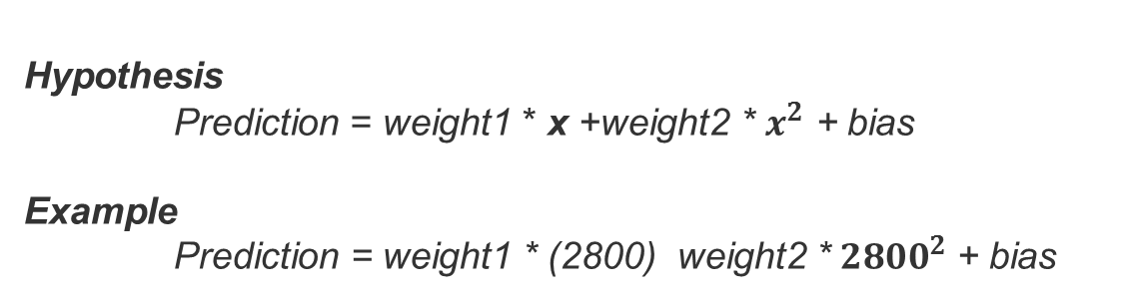
Polynomial Regression
Hypothesis
Prediction ​= weight1 * x +weight2 * $x^{2}$ + bias
Example
Prediction = weight1 * (2800) weight2 *${ 2800}^{2}$ + bias​

Slide 27
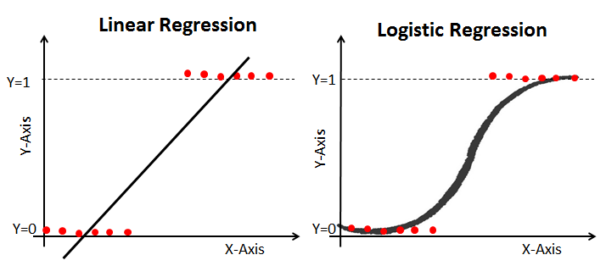
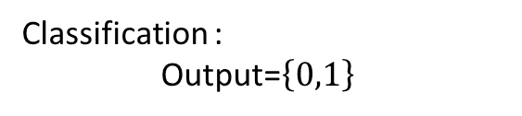
Logistic Regression(Classification)
Logistic regression is used when the response variable is categorical in nature.
Example :
Spam/Not spam
Win/Lose
Pass/Fail
Classification :
Output=$\left\{0,1\right\}$

Slide 28
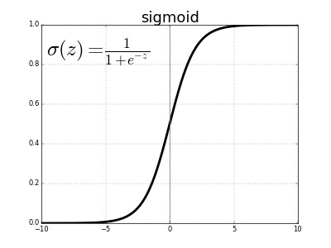
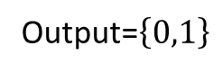

Example
Output=$\left\{0,1\right\}$
Hypothesis :
z ​= weight1 * x1+ weight2 * x2 + bias
Output should be in range (0<= z <=1)
Hypothesis = sigmoid(z)
Where Sigmoid(z)=$\frac{1}{1+e^{−z}}$

Slide 29
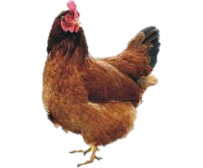
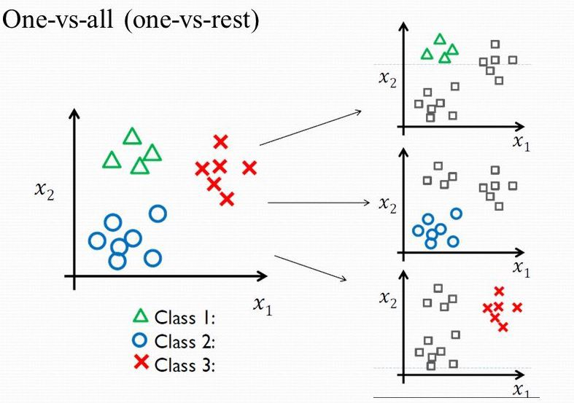

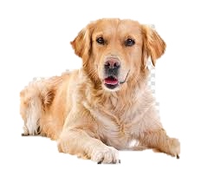
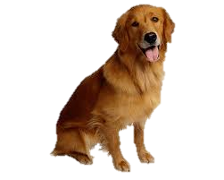
One vs all
l1
0
l2
0
l3
1
Max Index

Slide 30
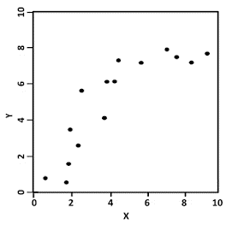
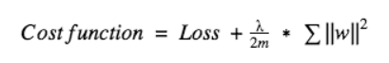
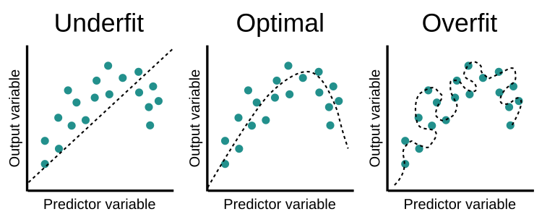
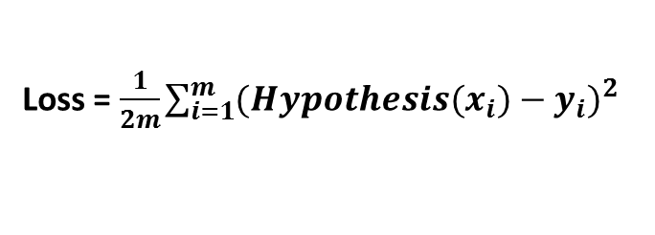
Regularization
Have you come across a situation where your model performed exceptionally well on train data, but was not able to predict test data.
Loss = $\frac{1}{2m}\sum_{i=1}^{m}{{(Hypothesis(x_{i})−y_{i})}^{2} }$

Slide 31

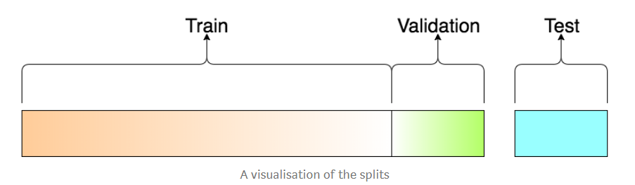
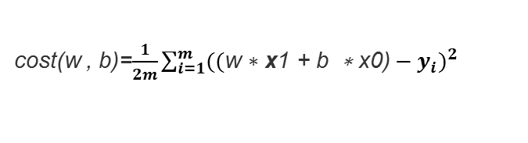
Applying Machine Learning
Vectorization
X
W(theta)
y
cost(w , b)=$\frac{1}{2m}\sum_{i=1}^{m}{{((\text{w}\text{ ∗ }\text{x}\text{1} \text{+ }\text{b}\text{ ∗ }\text{x}\text{0)}−y_{i})}^{2} }$
Non Vectorized Implementation
k=0
result=list()
for i in range(2):
ans=0
for j in range(2):
ans=ans+l1[i][j]*l2[j][k]
result.append((ans-l3[i][k])**2)
sum(result)
Cost=(1/2m)*sum(${\text{(}\text{x}\text{∗}\text{theta}\text{−}\text{y}\text{)}}^{2}$)
Vectorized Implementation of cost function
np.sum(np.square(np.dot(X, theta) - y))
Splitting the data
Training Set 60%
Cross validation Set 20% Test Set 20%

Slide 32
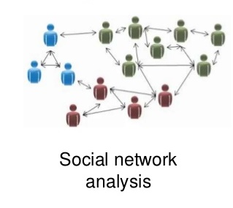
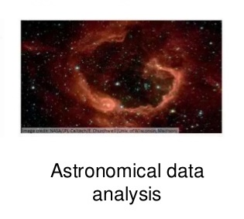
Unsupervised Learning
Unsupervised learning allows us to approach problems with little or no idea what our outputs should look like.
Examples :

Slide 33
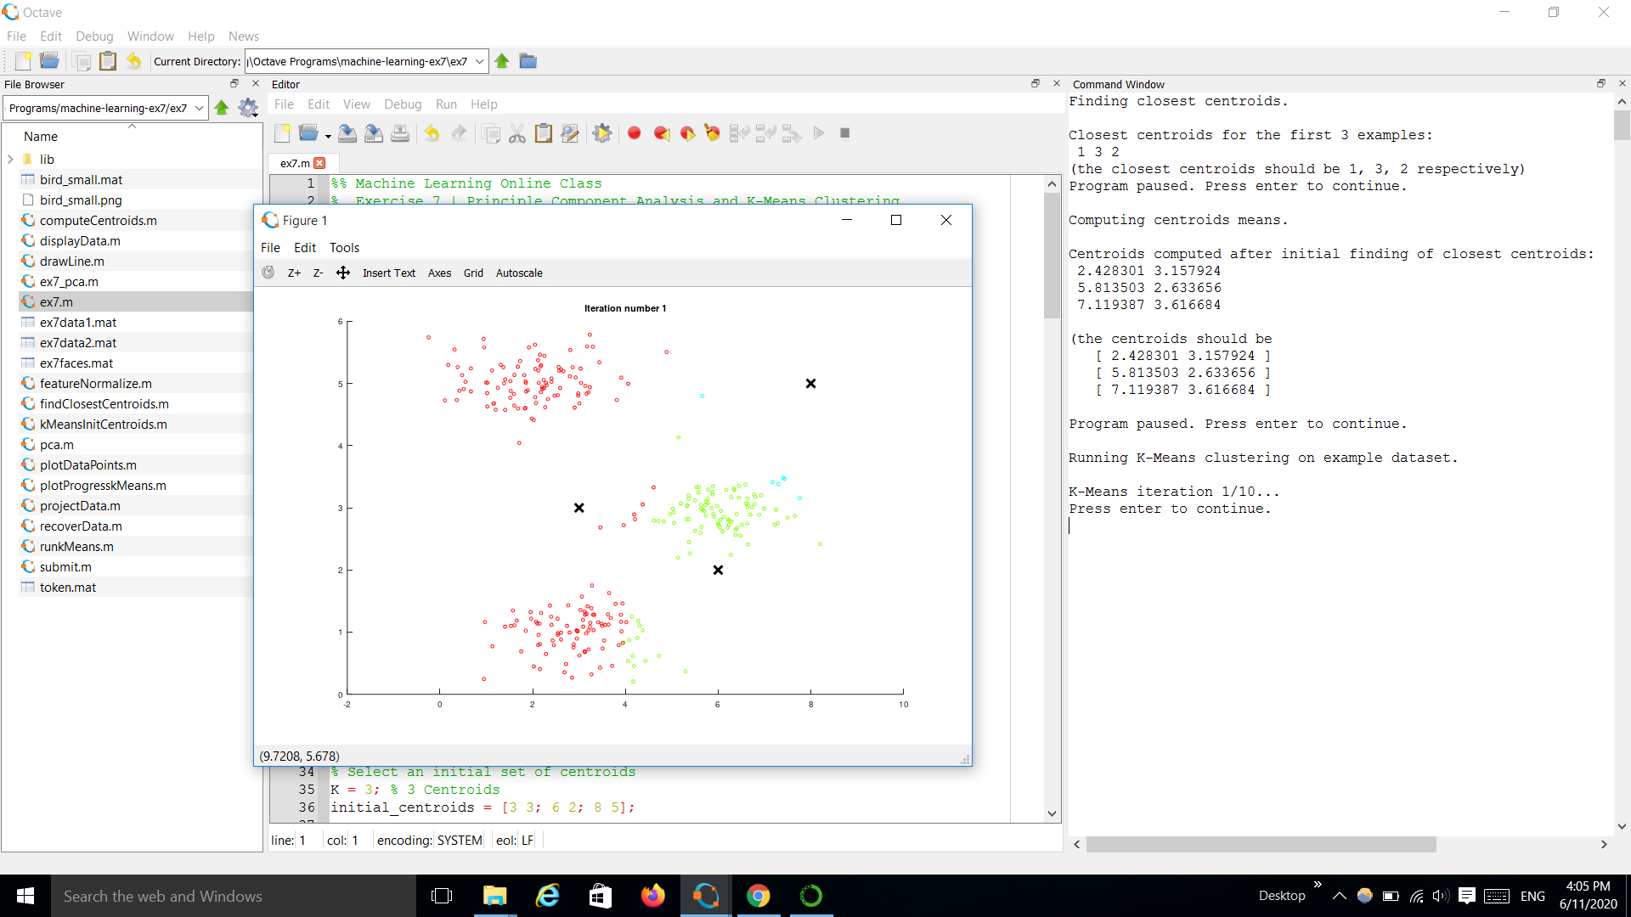
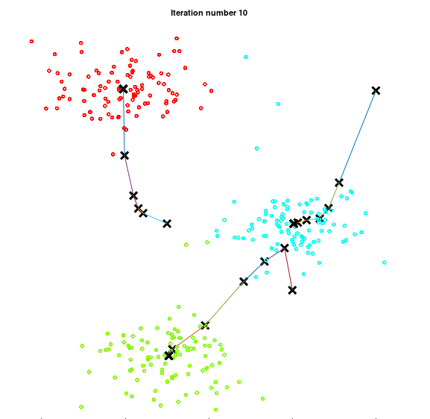
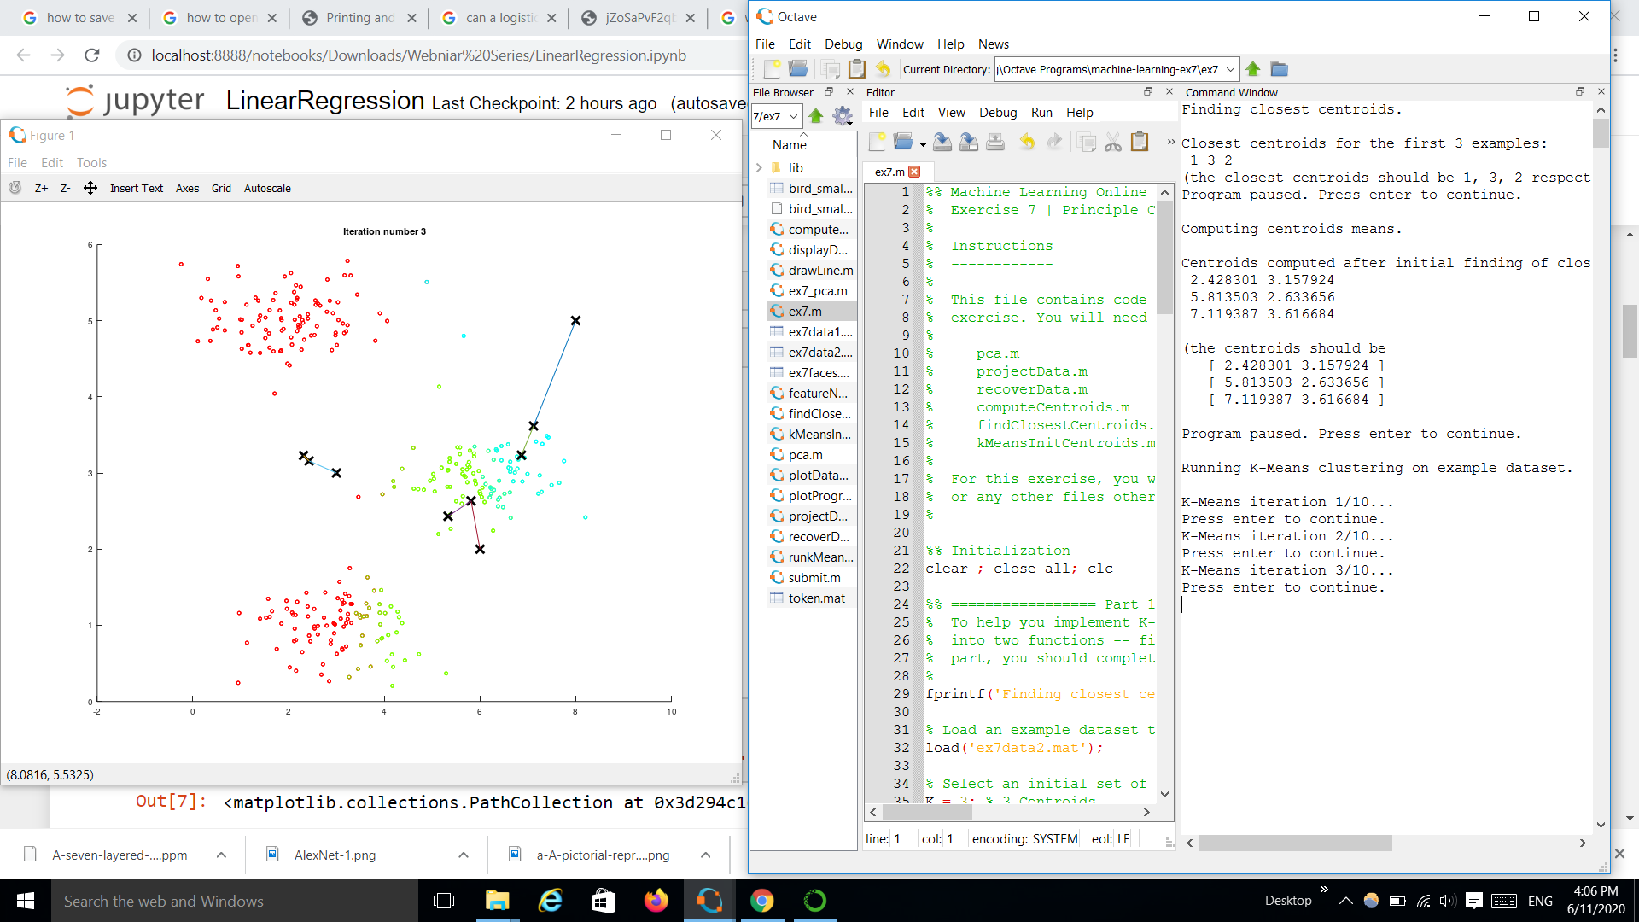
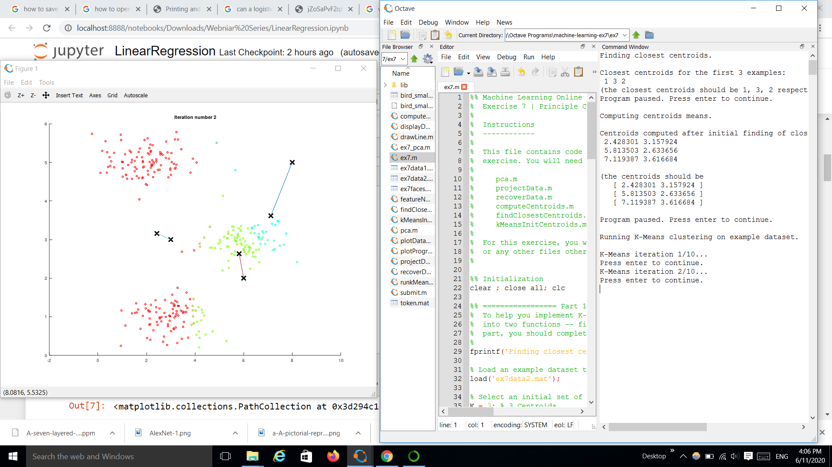
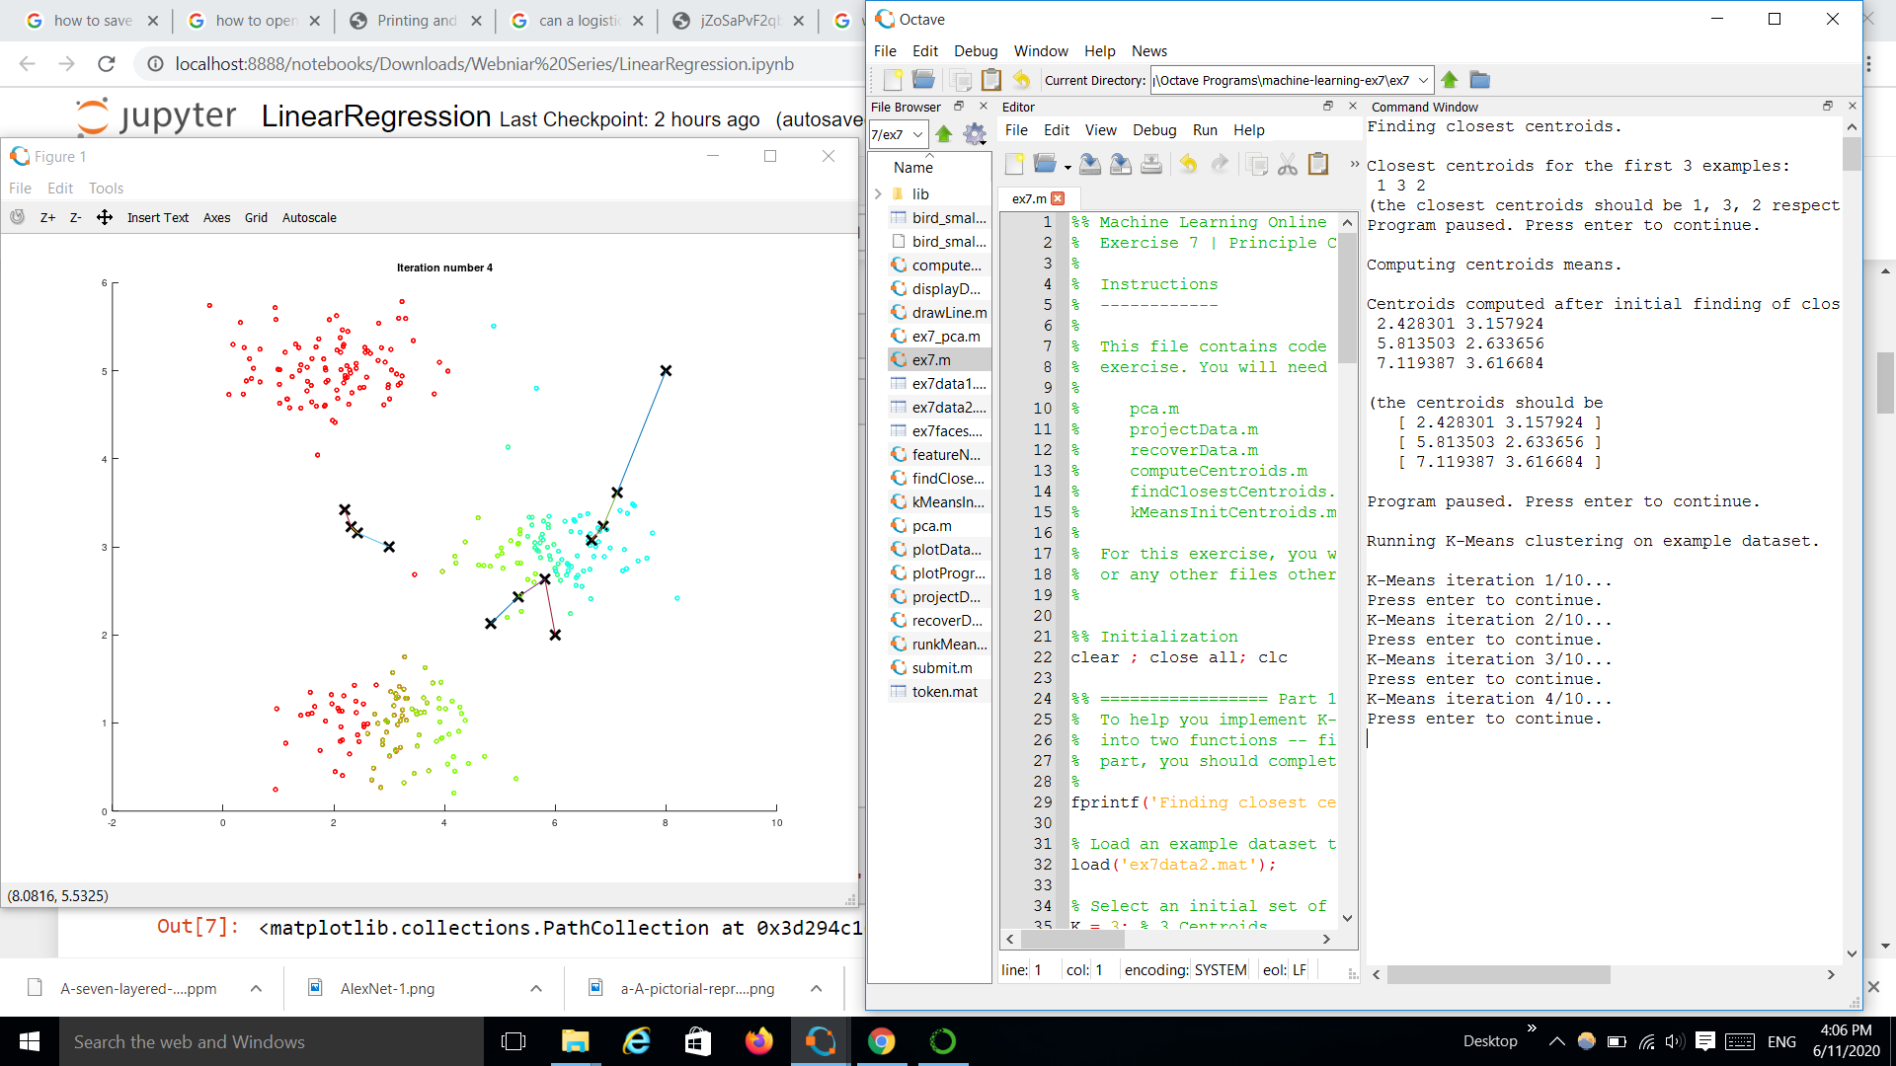
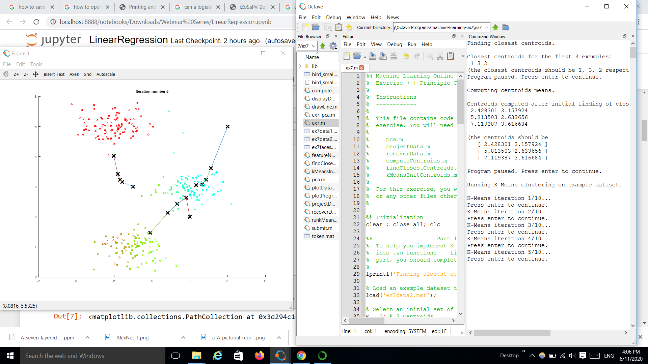
Clustering
K – Means Algorithm

Slide 34
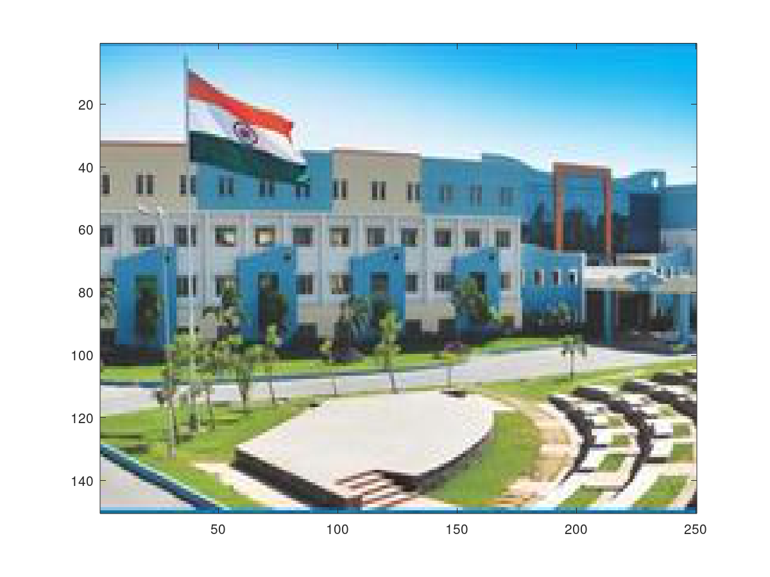
Image Compression
Pixel Value =(R,G,B)
R=0-255(8 bits)
G=0-255(8 bits)
B=0-255(8 bits)
Total 24 bits for each pixel
Original Image
Total Bits in an image = 250 x 150 x24= 900000 bits
Choose K = 8
Now there will be 250x150x3 + 24x8 = 112692 bits

Slide 35
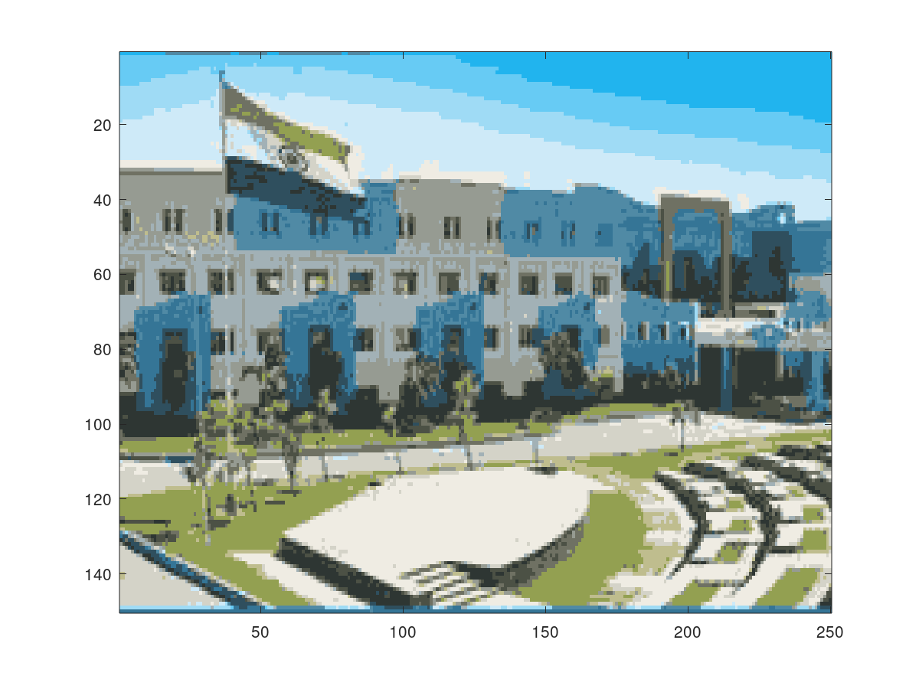
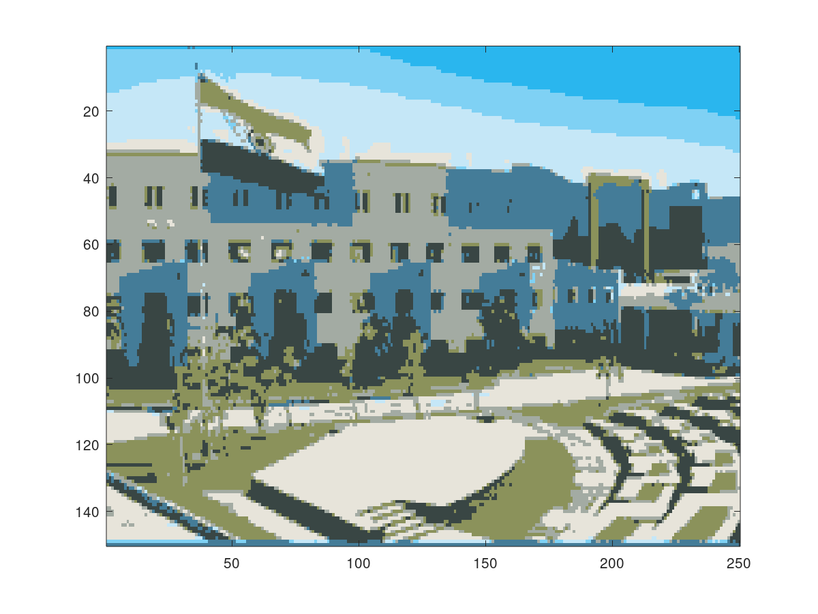
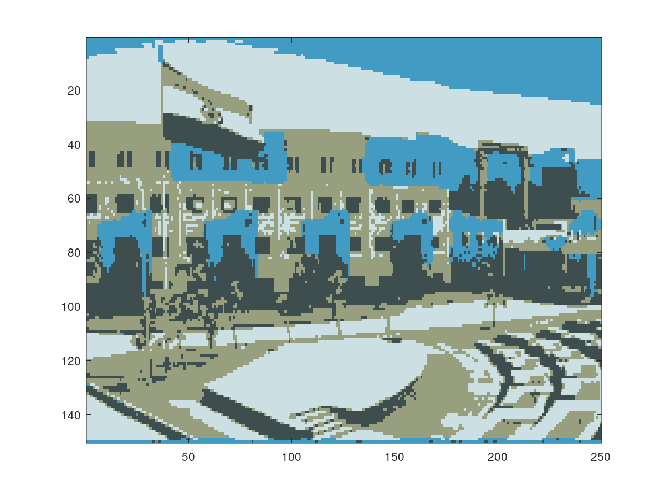
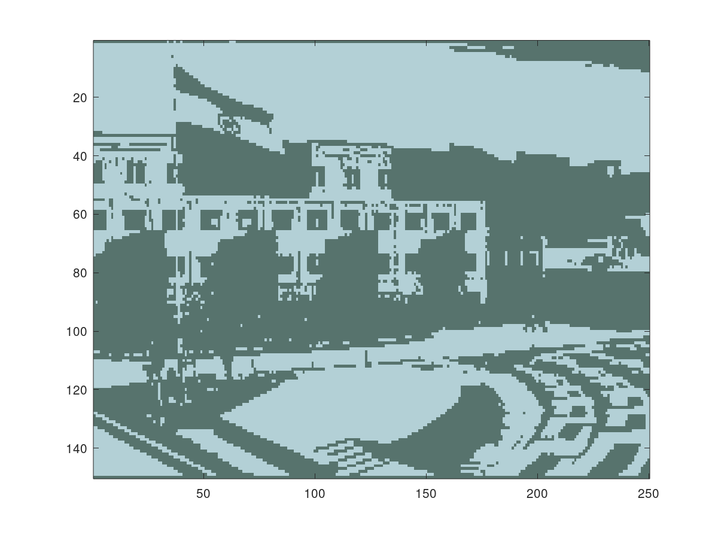
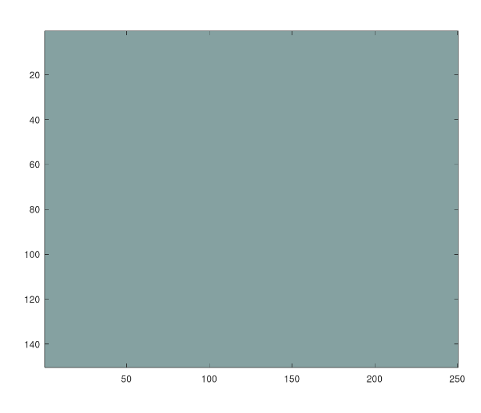
Image Compression
Original Image
K = 16
K = 8
K = 4
K = 2
K = 1

Slide 36
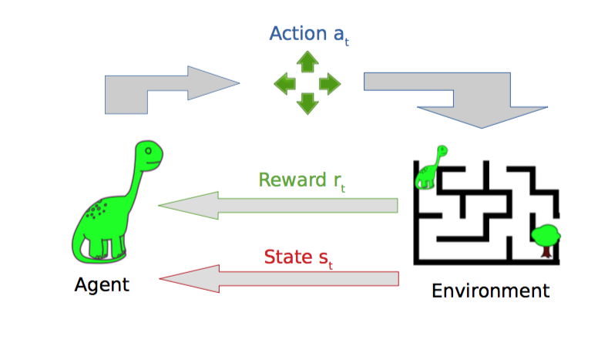
Reinforcement Learning
It is about taking suitable action to maximize reward in a particular situation. In the absence of a training dataset, it is bound to learn from its experience.
Example:
We have an agent and a reward, with many hurdles in between.

Slide 37
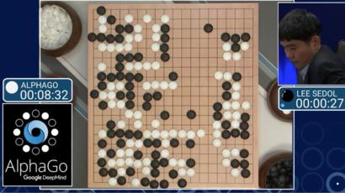
Google Atari Breakout
DQN finds and exploits the optimal strategy in this game, which is to make a tunnel around the side, and then allow the ball to hit blocks by bouncing behind the wall.
https://www.youtube.com/watch?v=TmPfTpjtdgg
Google Deepmind Alpha Go
AlphaGo is the first computer program to defeat a professional human Go player, a landmark achievement that experts believe was a decade ahead of its time.
https://www.youtube.com/watch?v=WXuK6gekU1Y

Slide 38
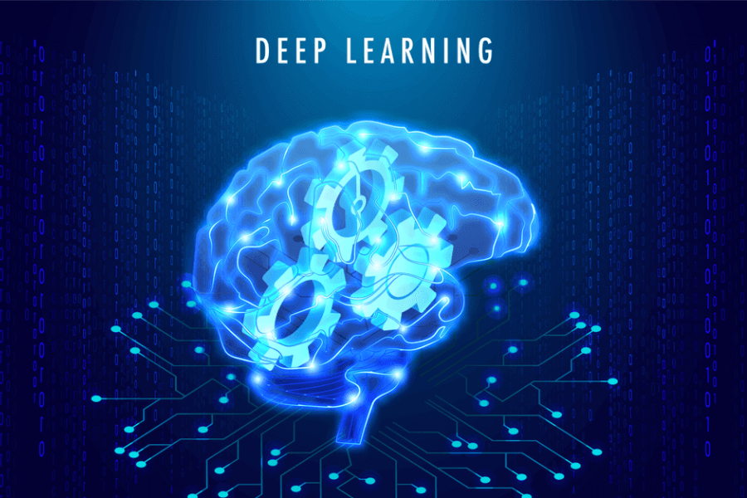

Slide 39
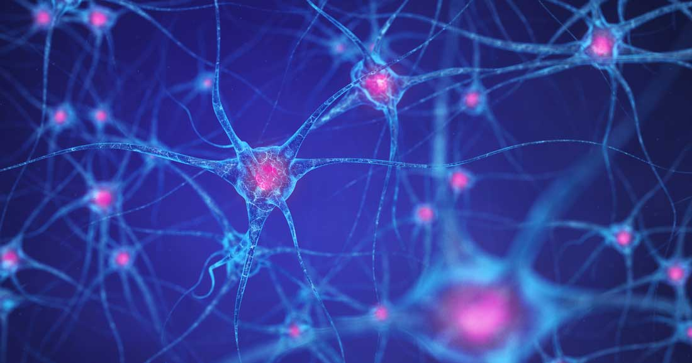

Deep Learning
Deep learning is a branch of machine learning which is completely based on artificial neural networks.
Neural Network is going to
mimic the human brain.
Performance

Slide 40

Neural Network

Slide 41


Digit Recognition

Slide 42


Convolutional Neural Networks
CNN are most commonly applied for analyzing visual imagery.

Slide 43


[Source - fastai]
https://github.com/fastai/fastai/tree/master/courses/dl1/excel

Slide 44

Applications of Machine Learning
Face detection
Virtual Personal Assistants
Social Media Services
Email Spam Filtering
Online Customer Support
Search Engine Result Refining
Product Recommendations

Slide 45
Programming Example
Linear Regression
Refer here
https://github.com/bharathikannan1311/Python/tree/master/Webinar
- includes all the resources and contains course notes which you can refer anytime.

Slide 46

Thank You!
For any queries
Mail id - bharathikannan1311@gmail.com
Github - https://github.com/bharathikannan1311/Python/tree/master/Webinar
Mobile – 9080512594

